Slide 1





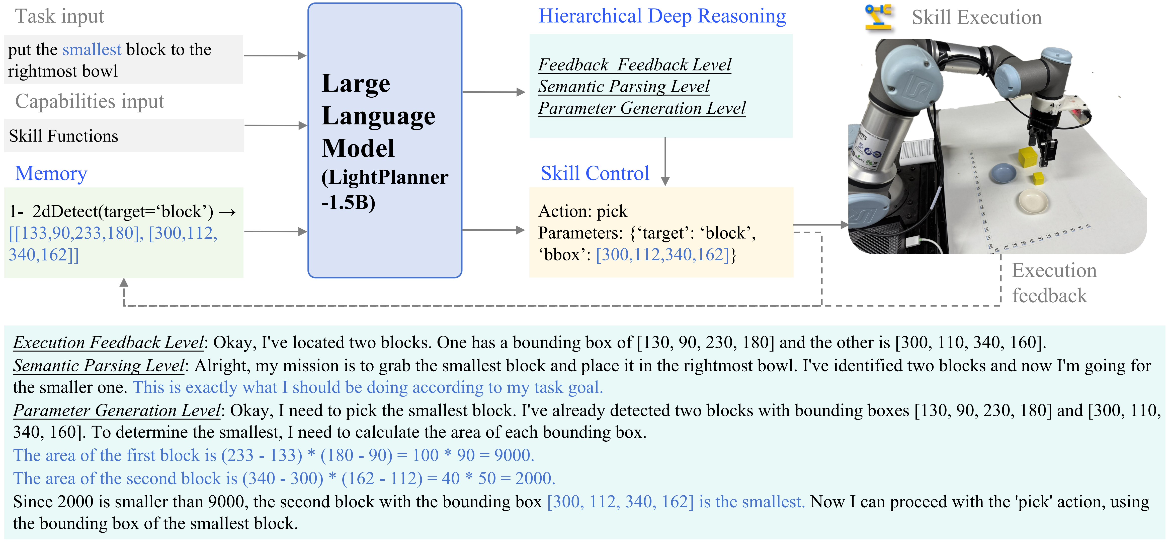
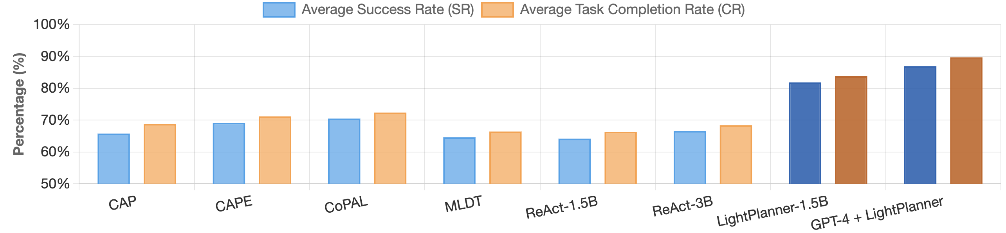
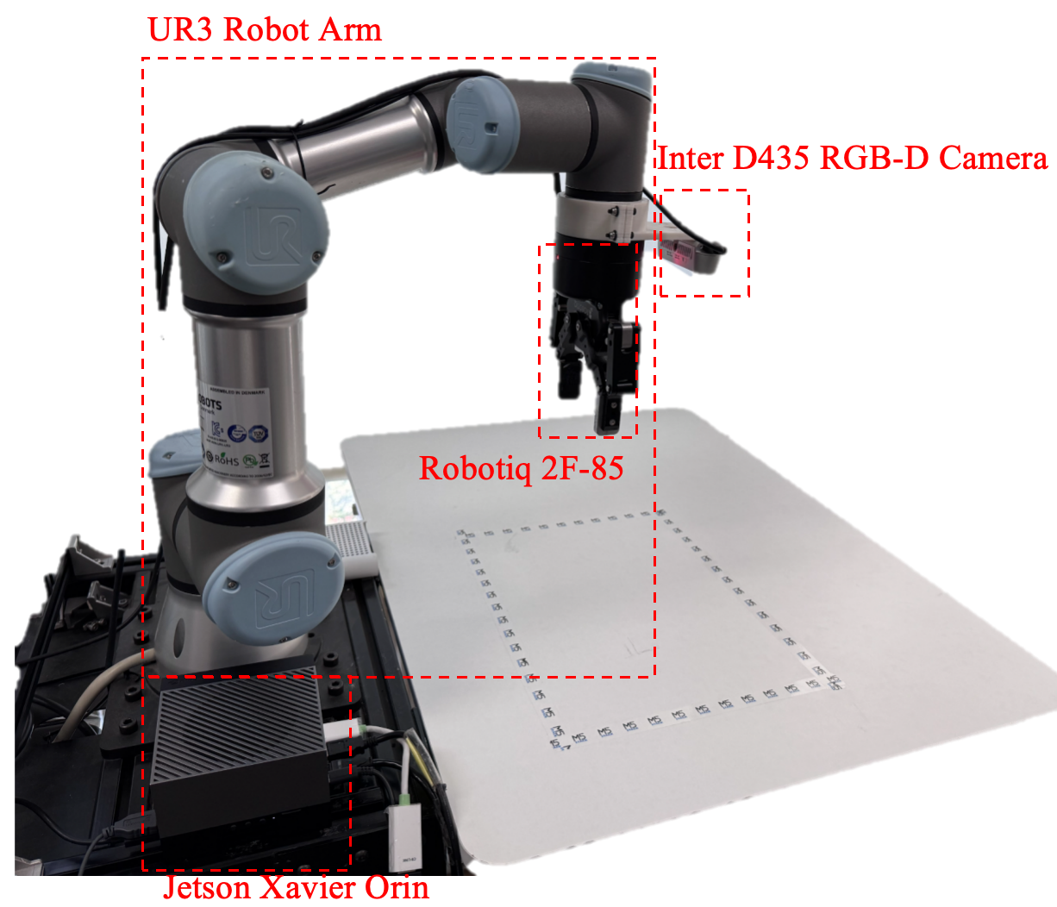
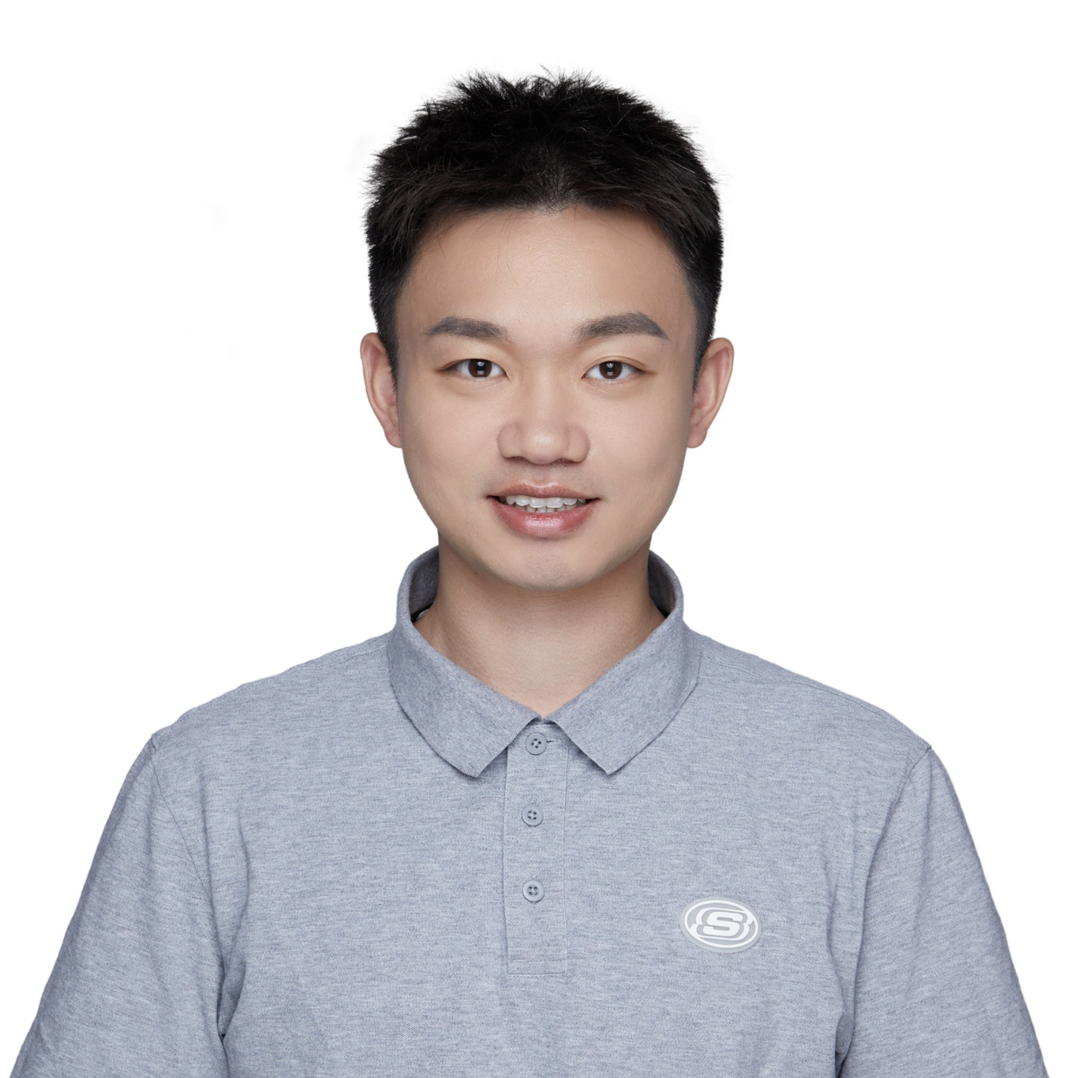

LightPlanner:
Unleashing the Reasoning Capabilities of Lightweight Large Language Models in Task Planning
Weijie Zhou, Manli Tao, Chaoyang Zhao, Honghui Dong, Ming Tang, Jinqiao Wang
Beijing Jiaotong University
Institute of Automation, Chinese Academy of Sciences
Introduction & Motivation
Goal: Enable lightweight Large Language Models (LLMs) to perform complex robotic task planning on edge devices.
Challenge: Standard lightweight LLMs (<3B parameters) excel at efficiency but fail in tasks requiring multi-step, dynamic logical reasoning (e.g., "pick the largest block").
Problem: Existing methods rely on high-performance LLMs (like GPT-4) or use fixed skill templates that lack flexibility for dynamic commands.
Our Solution: LightPlanner, a novel planner that enhances the reasoning of small LLMs to achieve high success rates in complex tasks
The LightPlanner Framework
Key Results
Weijie Zhou
PhD. Candidate
BJTU & CASIA
Elonzhou99@gmail.com
https://jetteezhou.github.io
My research bridges Embodied AI and MLLMs to build intelligent agents that perceive, reason, and act in the physical world.
First-author publications at IROS'25, CVPR'25, & NIPS'25.
Contributed to the TAIROS platform at Tencent Robotics X Lab, earning the Outstanding Intern Award (1 of 5 recipients).
Seeking collaborations in Embodied Cognition and Decision-making.

